Slide 1
— Senior Design —
Online Processing for Molten Salt Reactors
David Barnett, davidbb2
Nathan Glaser, nglaser3
Joseph Specht, jspecht3

Slide 2
Project Overview

Slide 3
Table of Contents
Background
Project Goals
Fission Products
Removal Methods
Cost Analysis
Conclusions

Slide 4
Background

Slide 5
Future of Nuclear Energy
Energy demand is projected to increase rapidly in coming decades
Nuclear is most promising clean energy source
Lowest land use per unit electricity generated
High reliability (>90% CF), mostly independent of environment
Current limitations
Radioactive Waste
Economics
Politics
Safety in extreme accident scenarios
Notes:
David

Slide 6
Molten Salt Reactors
One of the six types of Advanced (Generation IV) Reactors [1]
Salt-cooled or liquid-fueled (MSR)
Salt-cooled
Similar to LWR, but with molten salt instead of water
Liquid-fueled
fuel form is UF₆ dissolved in FLiBe
fuel is pumped throughout the primary system
Notes:
David

Slide 7
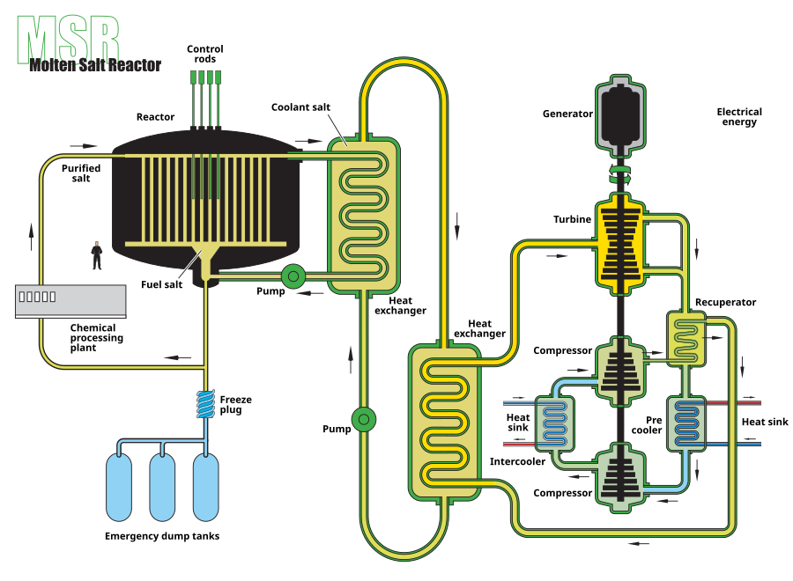
History of Molten Salt Reactors
ARE in 1954 at ORNL
MSRE in 1965 at ORNL.
First to run on ²³³U in 1968
MSBR designed at ORNL with industry in early 1970s
Program shut down in favor of liquid metal fast reactors
limited by technology at the time
Notes:
David (https://www.ornl.gov/molten-salt-reactor/history)

Slide 8
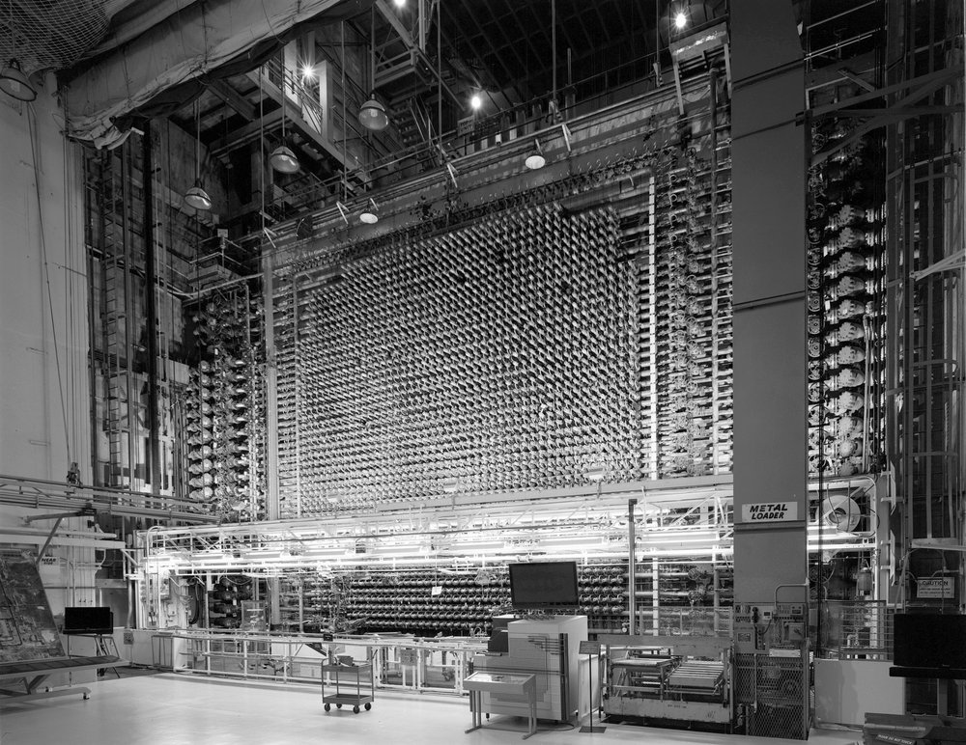
Advantages of Molten Salt Reactors
Flowing fuel enables online / batchwise fuel processing
Optimal for breeding in both thermal and fast regimes
Can operate with diverse fuel cycles
Th-U, U-Pu, SNF
Can be used to burn transuranic waste (TRU)
TRU is long lived, but all are fissile / fissionable / breedable
Load following on a reactor basis
not fleet
Notes:
David
https://www.harleycowan.com/manhattan-project

Slide 9
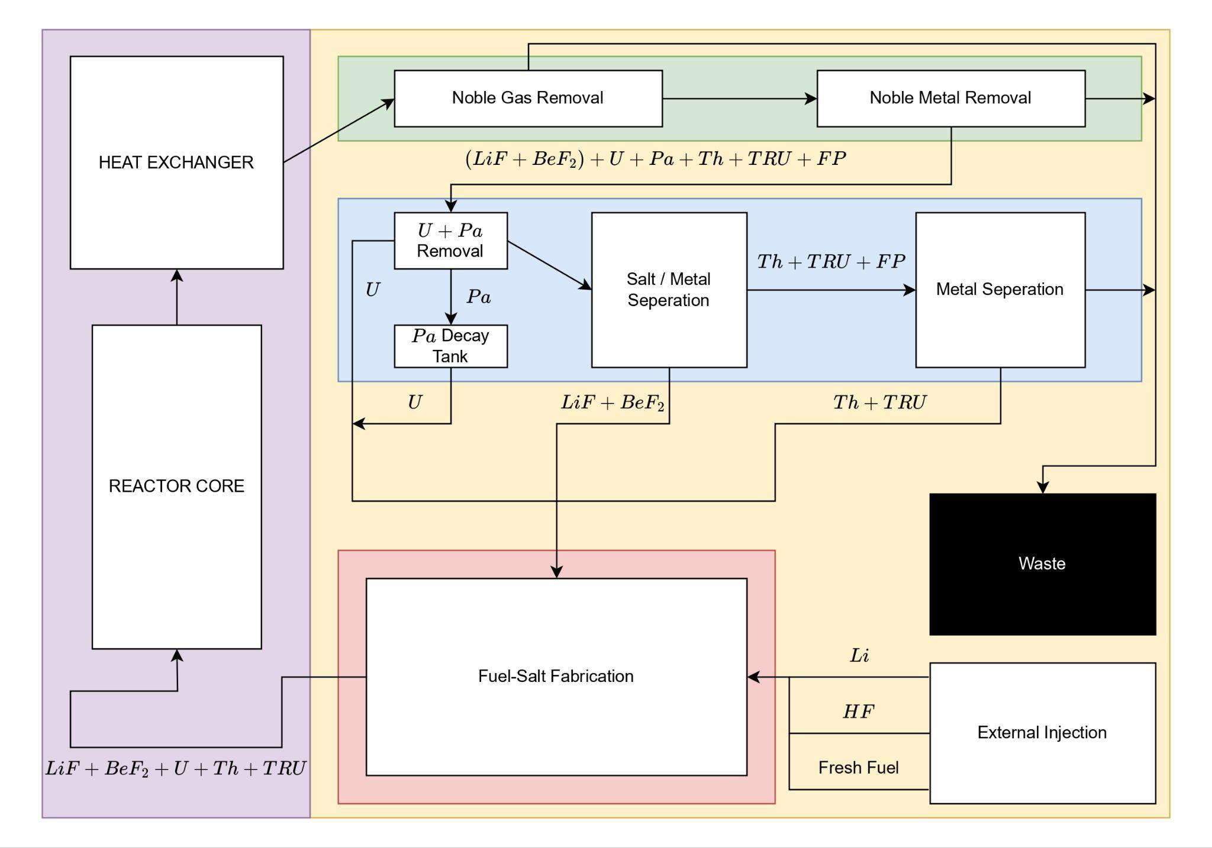
Online and Batchwise Processing
Online processing
all fuel salt flows through processing prior to reentry
fine control over total salt inventory’s chemistry
Batchwise processing
Siphon off a portion of the fuel salt to process
fine control over portion of salt inventory’s chemistry
Notes:
David

Slide 10
Online and Batchwise Processing
Looking at efficacy of fuel processing, ceteris paribus, online is better
nonproliferation, control, breeding ratio
Batchwise processing is standard due to technological limitations
Two processes are the limiting reactants technologically (1960s-70s)
Gas sparging for fission gas removal
Uranium separation from fuel salt
Notes:
David

Slide 11
Challenges of Molten Salt Reactors
Flowing fuel introduces fission product transport throughout primary system
Tritium production of 2.89 𝜇g per second ( 91 grams per year)
Noble metals plate out on metallic structures (HX) kW of decay heat
Fuel salt is highly corrosive, limits material choices
Graphite, Hastelloy-N, Nickel, Molybdenum are only viable materials
Awkward outlet temperature regime (621-705C)
Upper bound for Rankine
Lower bound for Helium Brayton
Fission gas removal and uranium separation in an online manner
Notes:
David

Slide 12
Project Goals

Slide 13
Project Goals
Maximize
Thermal efficiency
Fuel utilization / breeding ratio
Component lifetime (Corrosion, DPA, HX plate-out)
Minimize
Worker Dosage
Total fuel-salt inventory
Concentrations of neutron poisons in the fuel-salt
Proliferation risk of processing

Slide 14
Fission Products

Slide 15
Products of Interest
Thorium, protactinium, and uranium
The breeding chain
Transuranics
Do not want to put into waste stream, rather burn
Fission gasses
Xe, I, Kr
Lanthanides
Parasitic absorbers, not fissile / fissionable / breedable
Tritium
Dominant culprit for dosage due to mobility

Slide 16
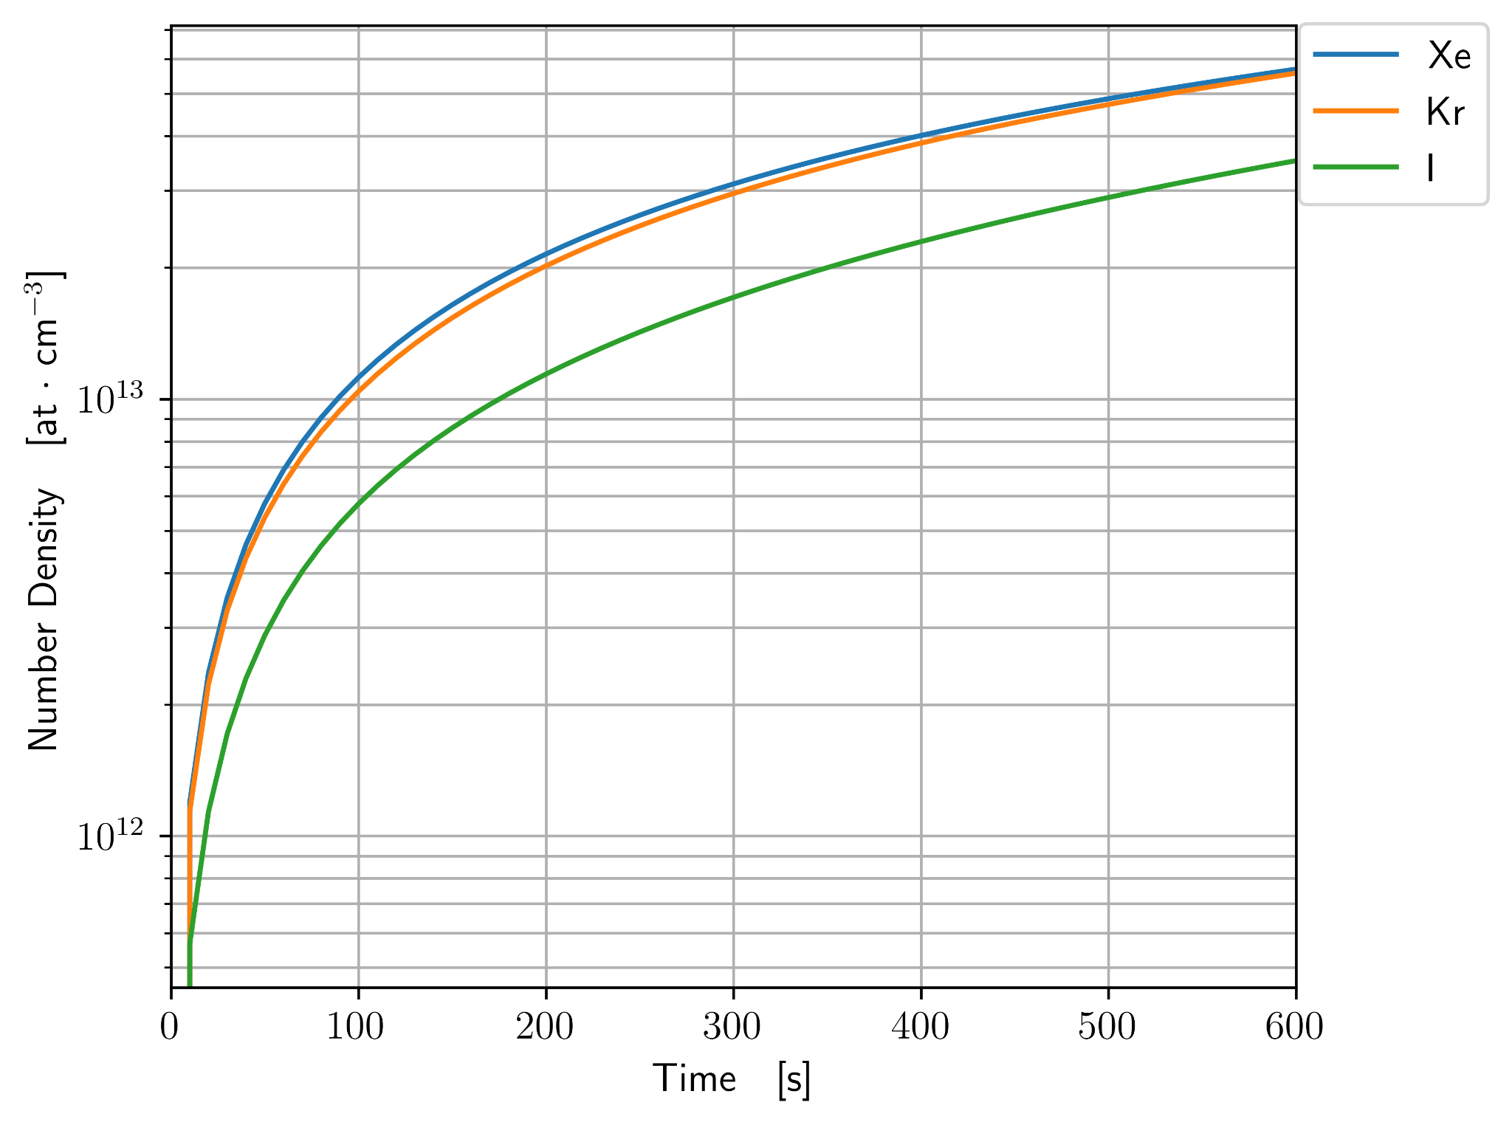
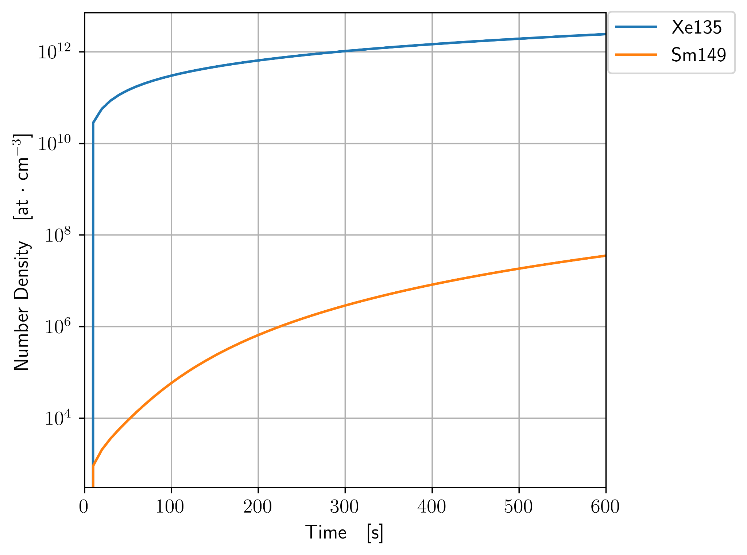
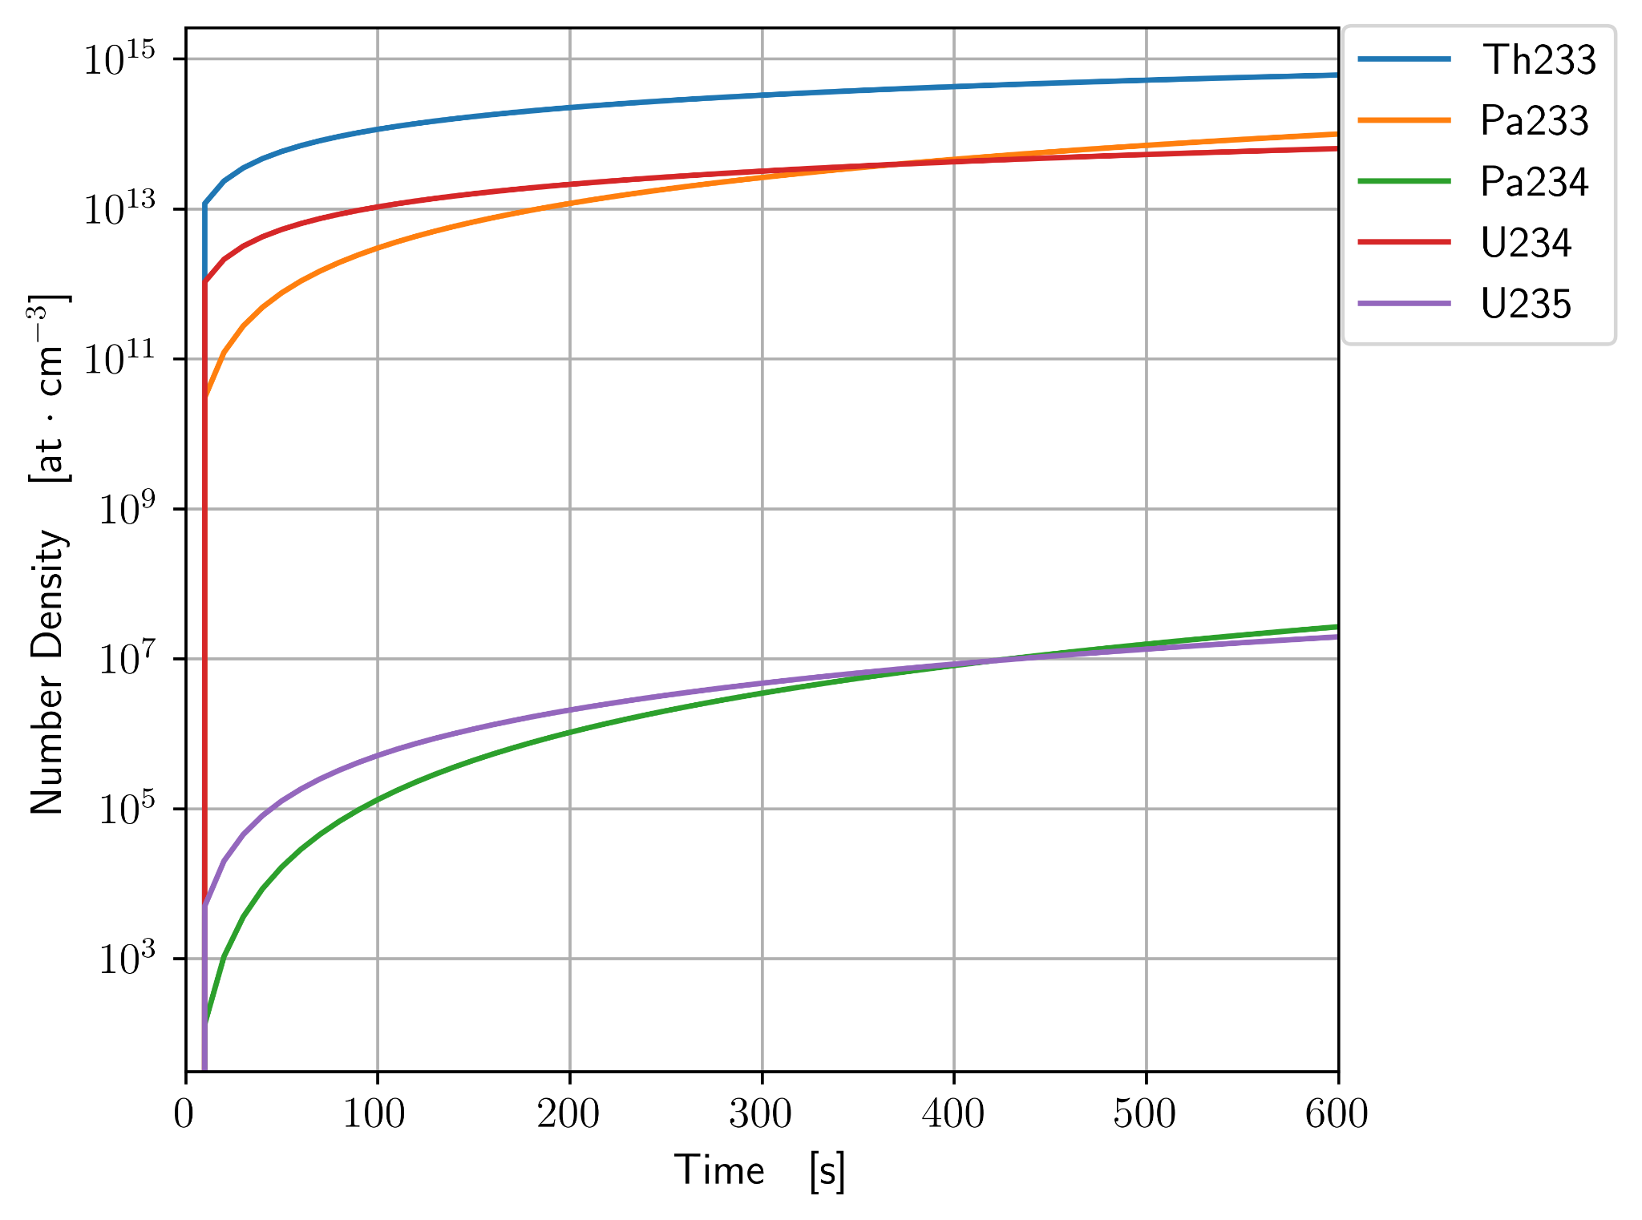
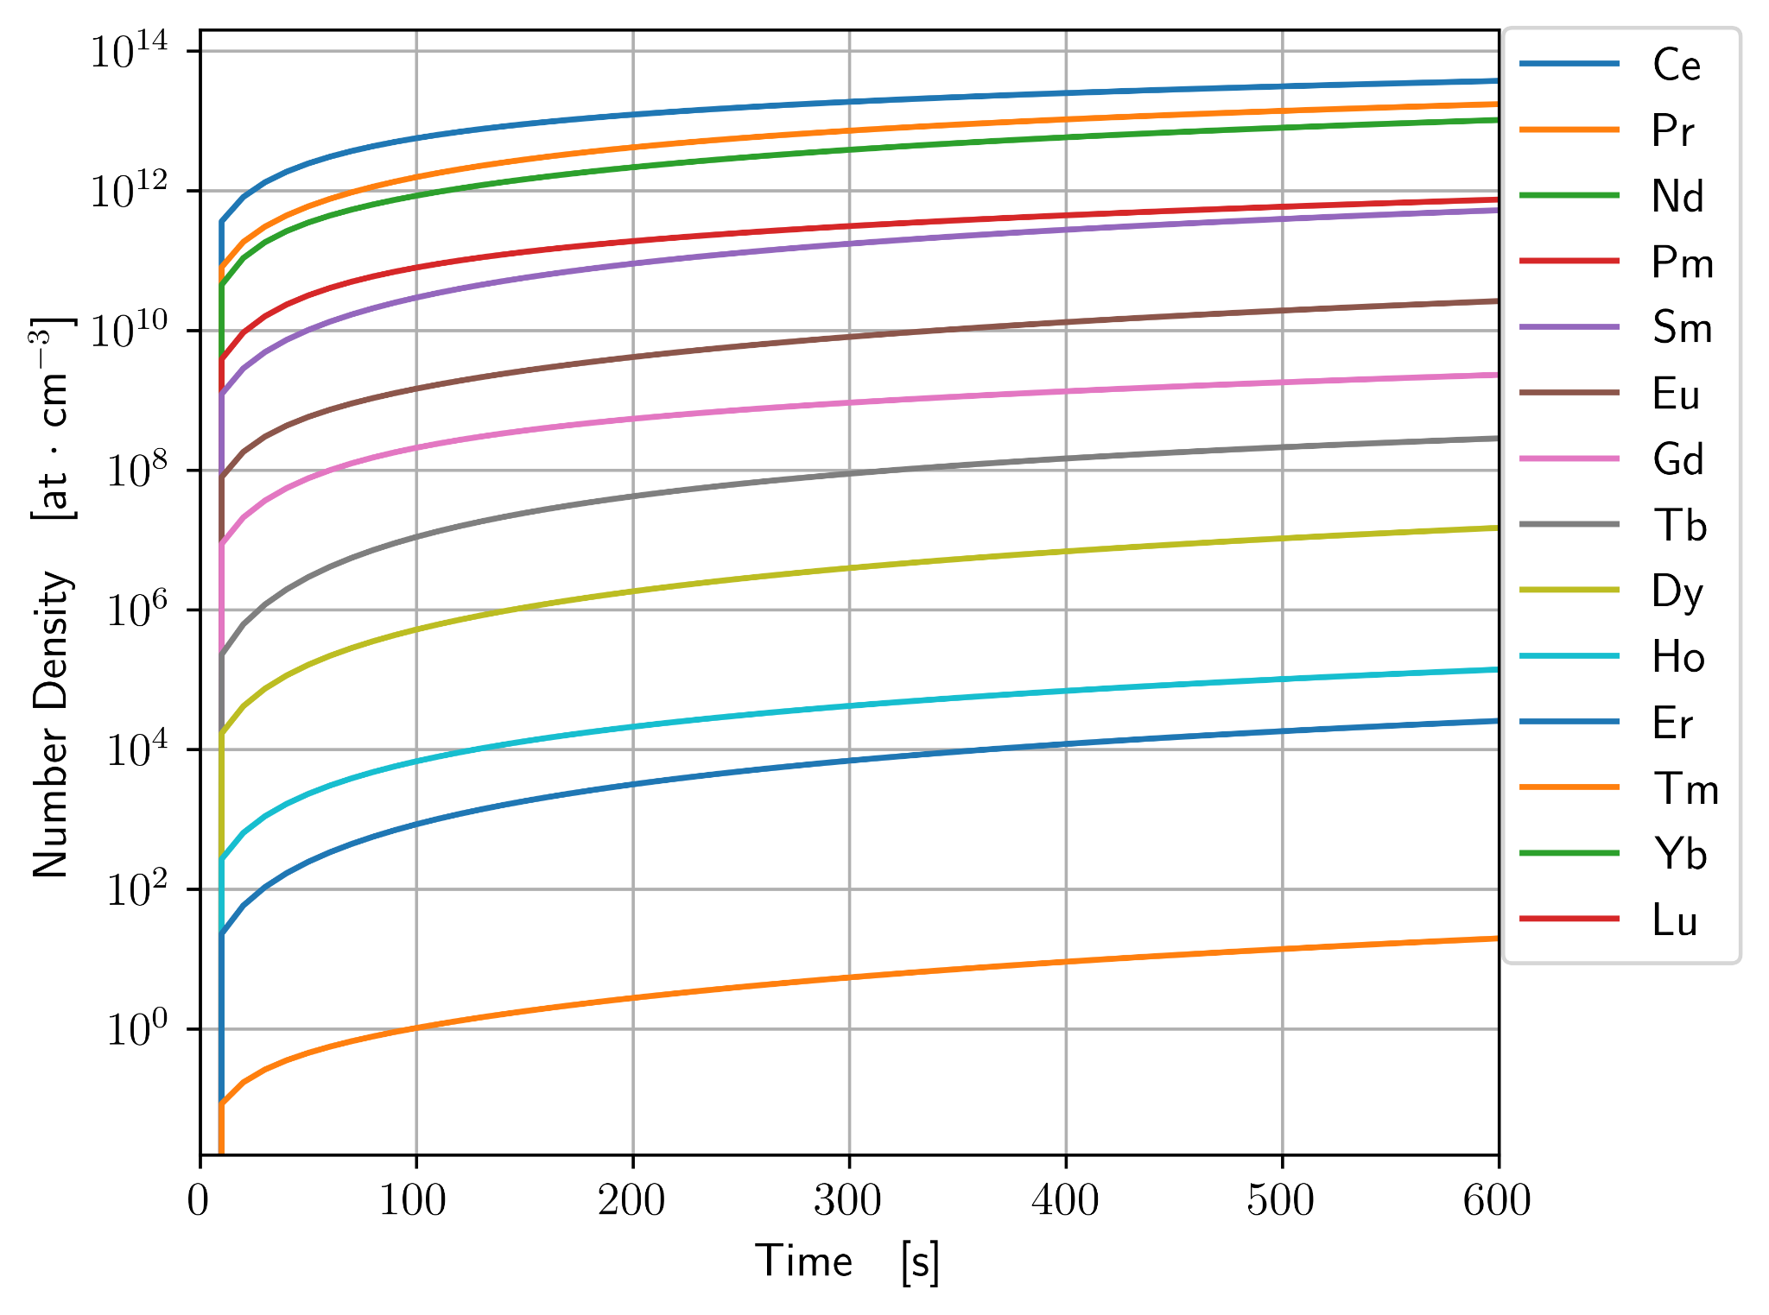
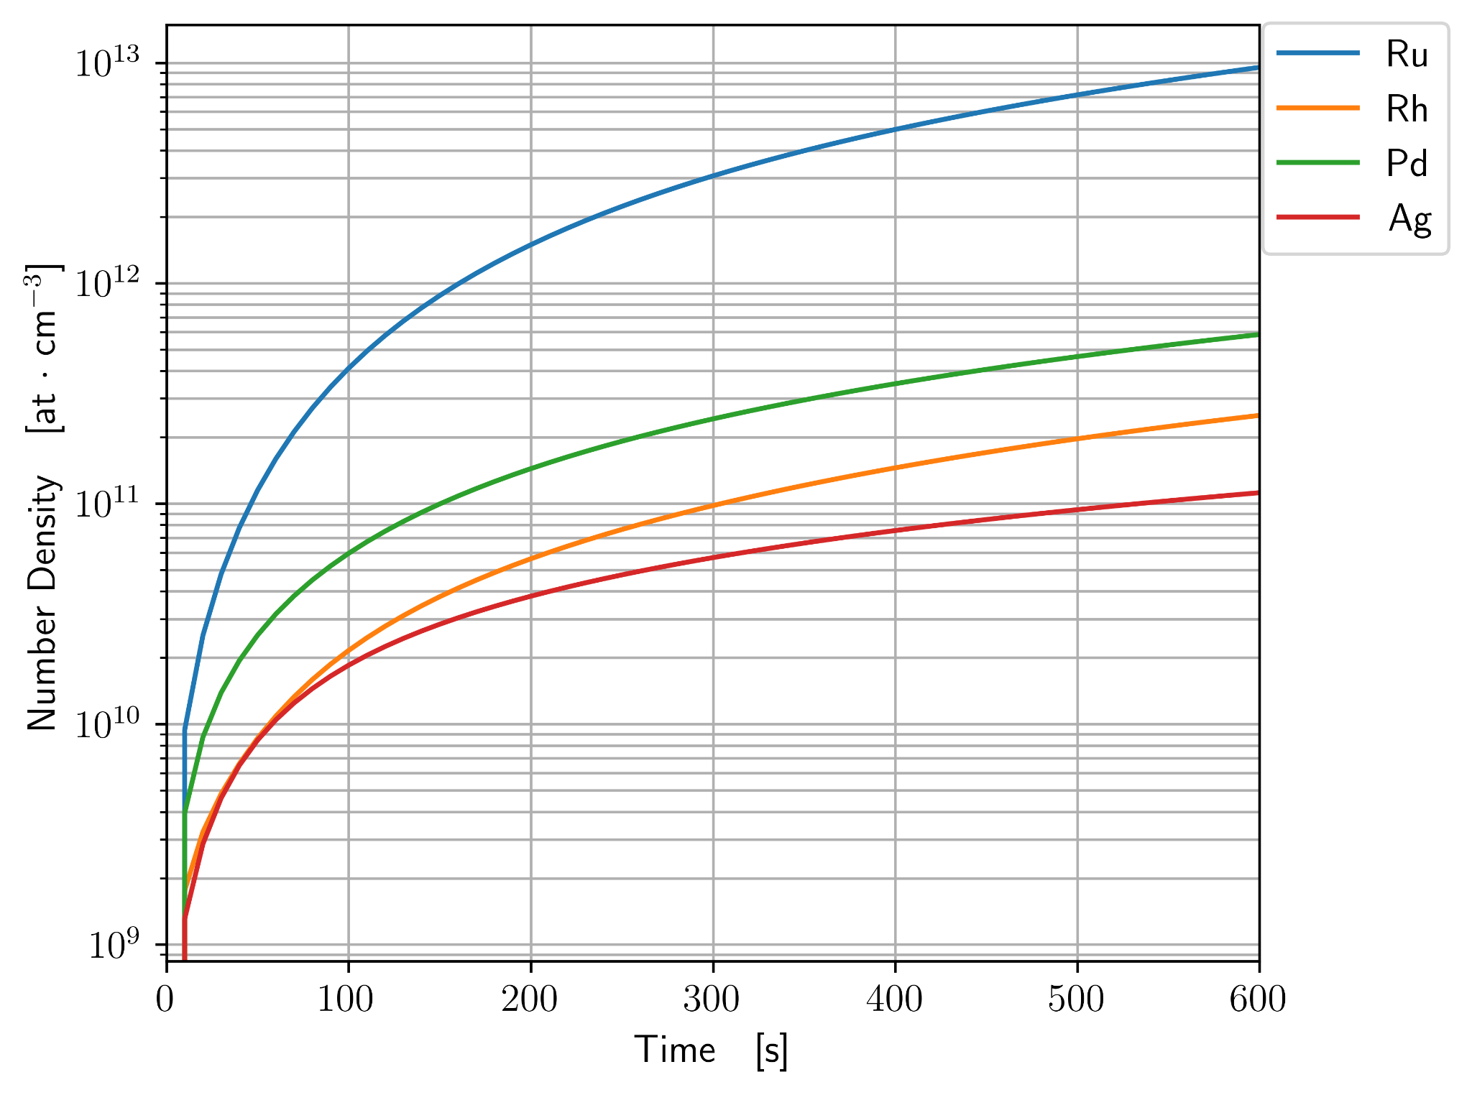
Source Rates

Slide 17
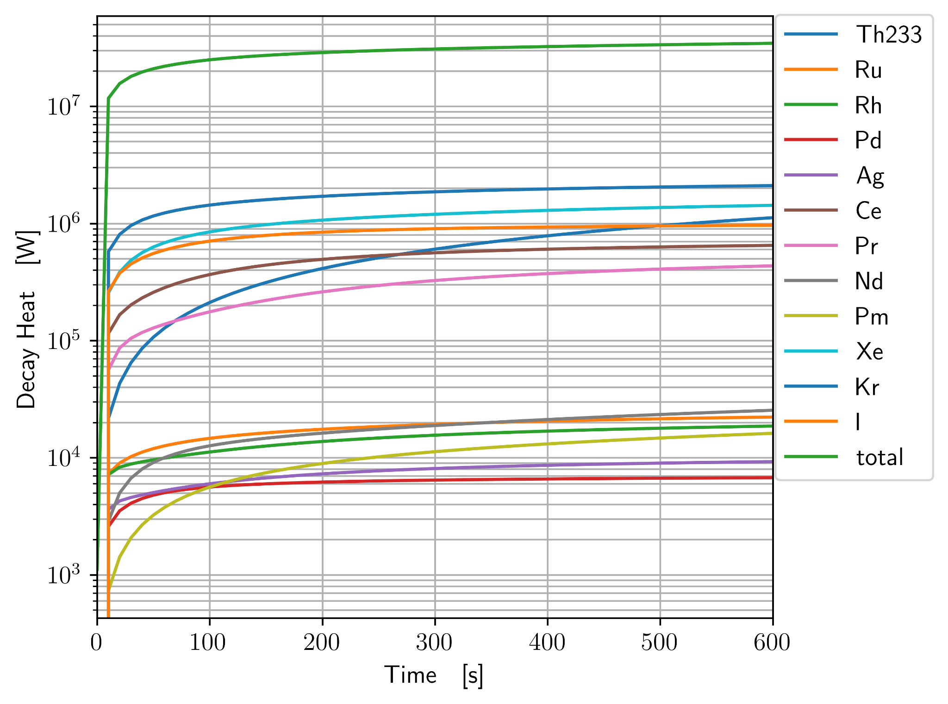
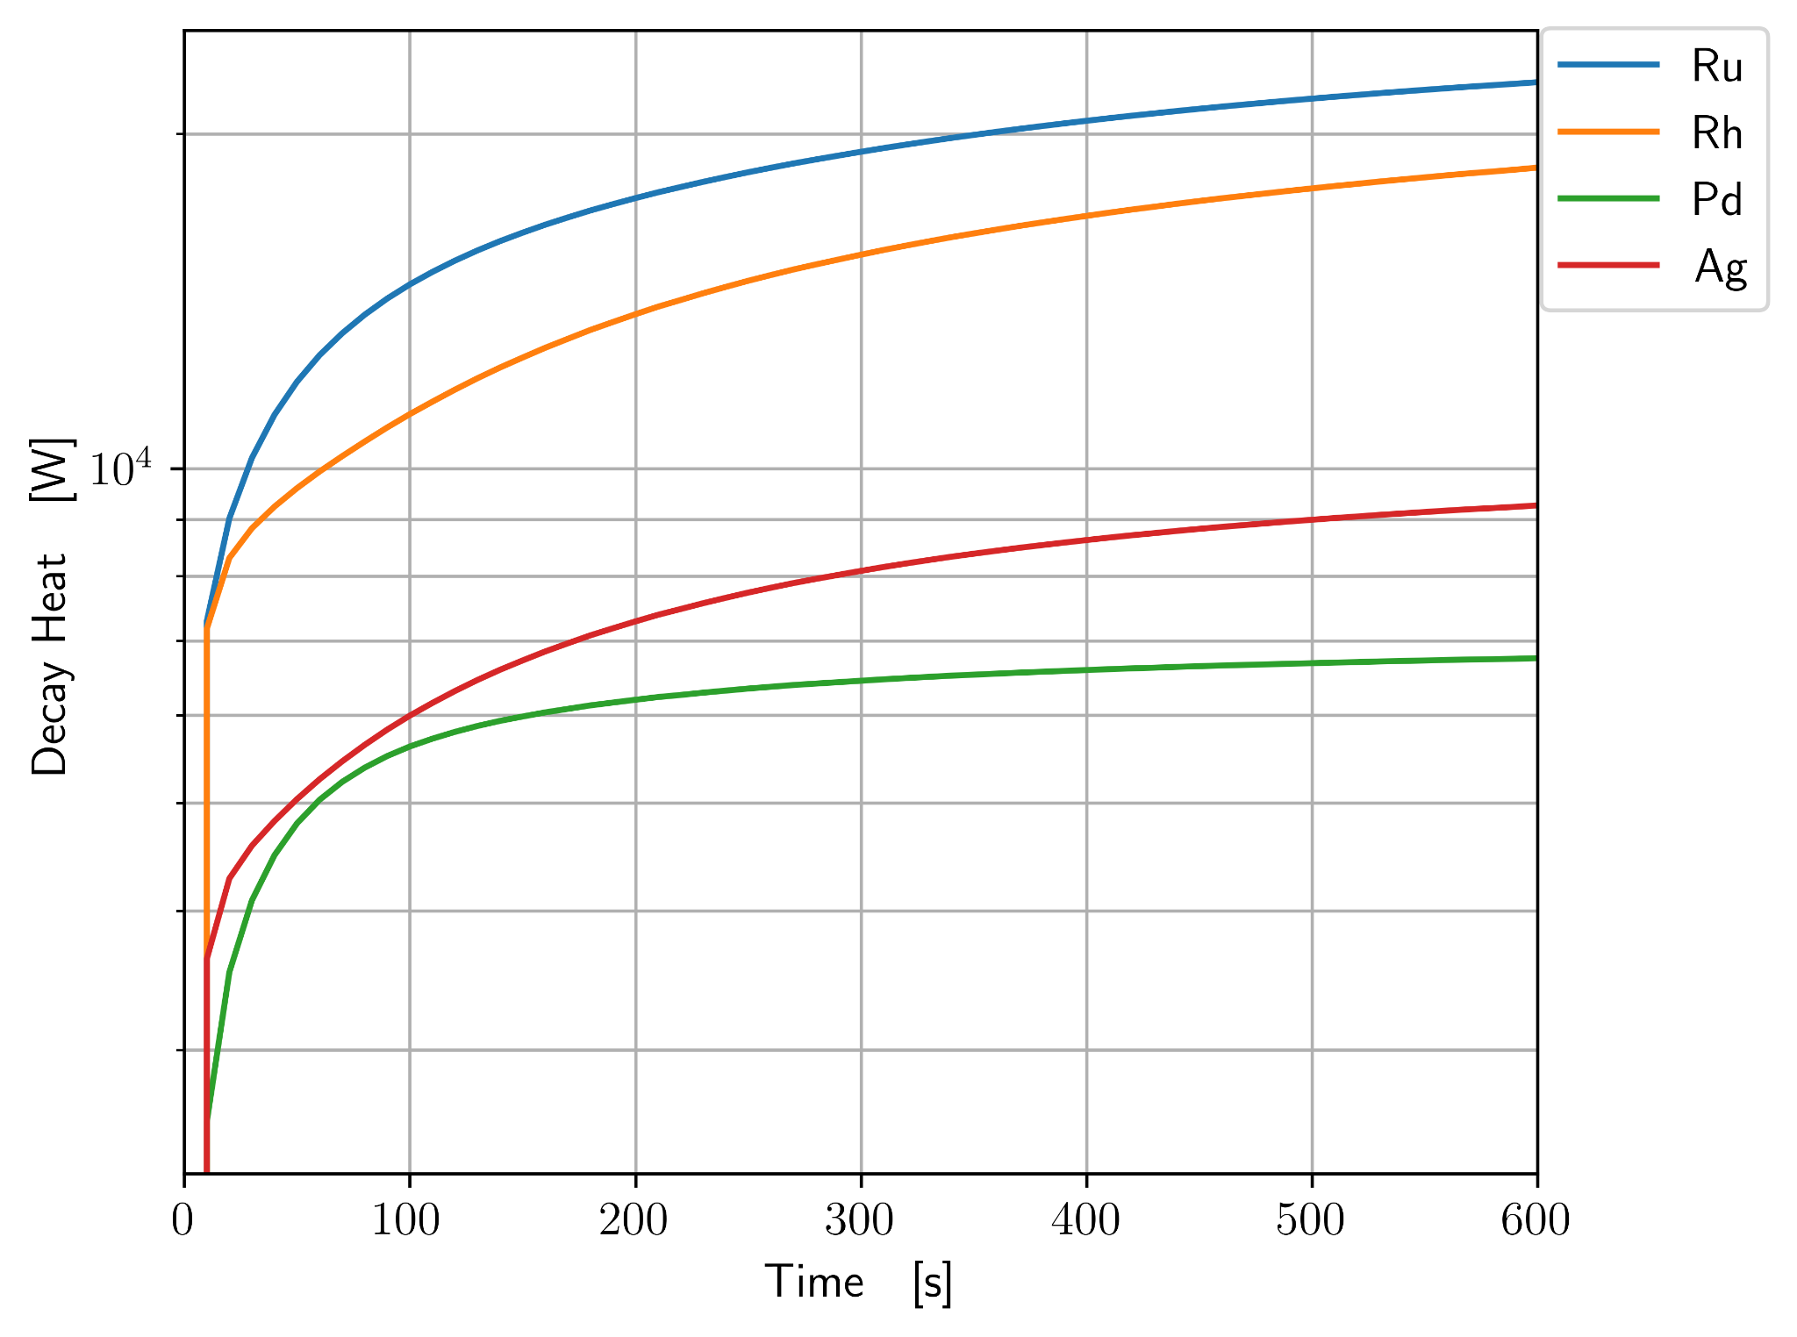
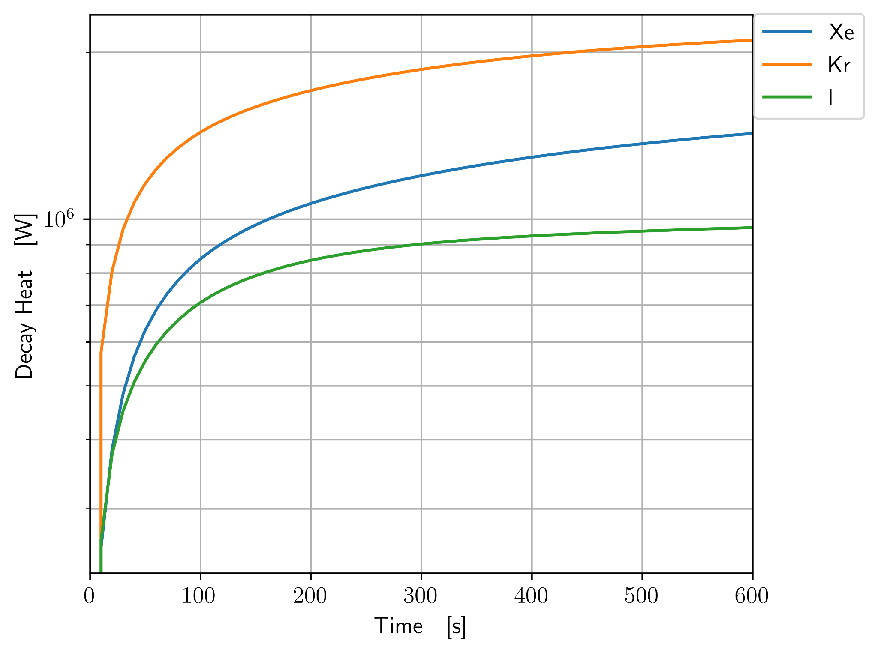
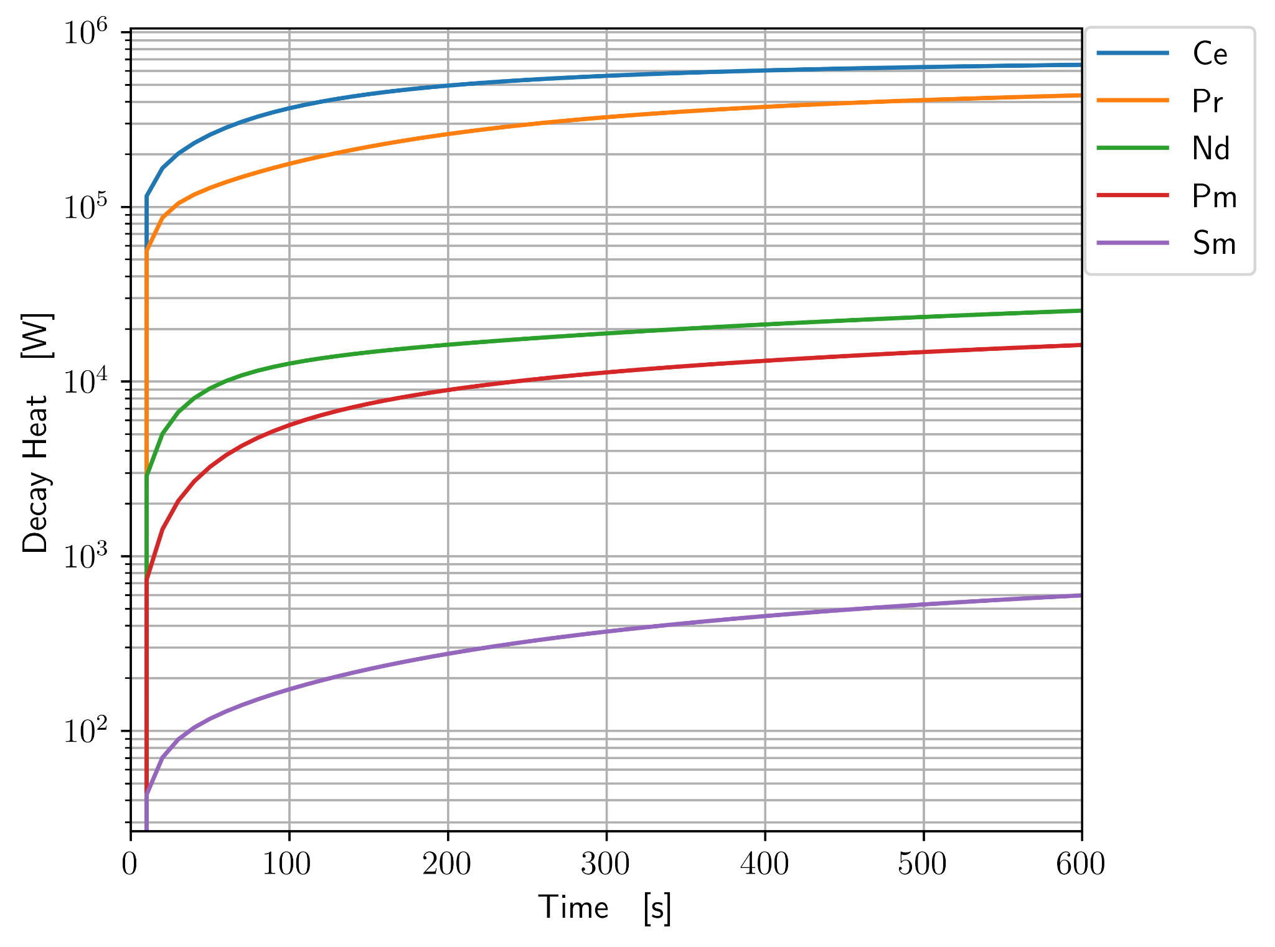
Decay Heat at Shutdown

Slide 18
Removal Methods

Slide 19
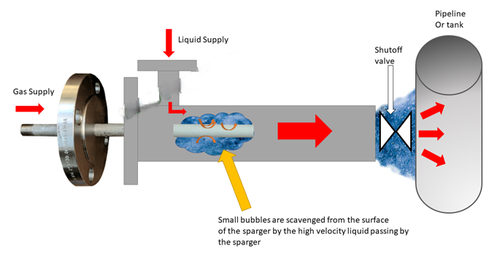
Gas Sparging and Separating
Sparge inert gas through fuel-salt
Fission gasses diffuse into inert gas
99.9% diffuse in ~20 seconds
Separate gas from fuel-salt and filter out removed solids
Force gas through charcoal beds to scrub out fission gasses
Recycle inert gas
Notes:
different picture

Slide 20

Metallic Filter
Noble metals selectively plate-out on metallic surfaces
Chose nickel due to affinity, corrosion resistance, cost
High surface area ‘sponge’
sacrificial surface for plate-out
Notes:
https://www.rinkerpipe.com/blog/how-to-choose-the-right-pipe-shape-for-your-project/

Slide 21
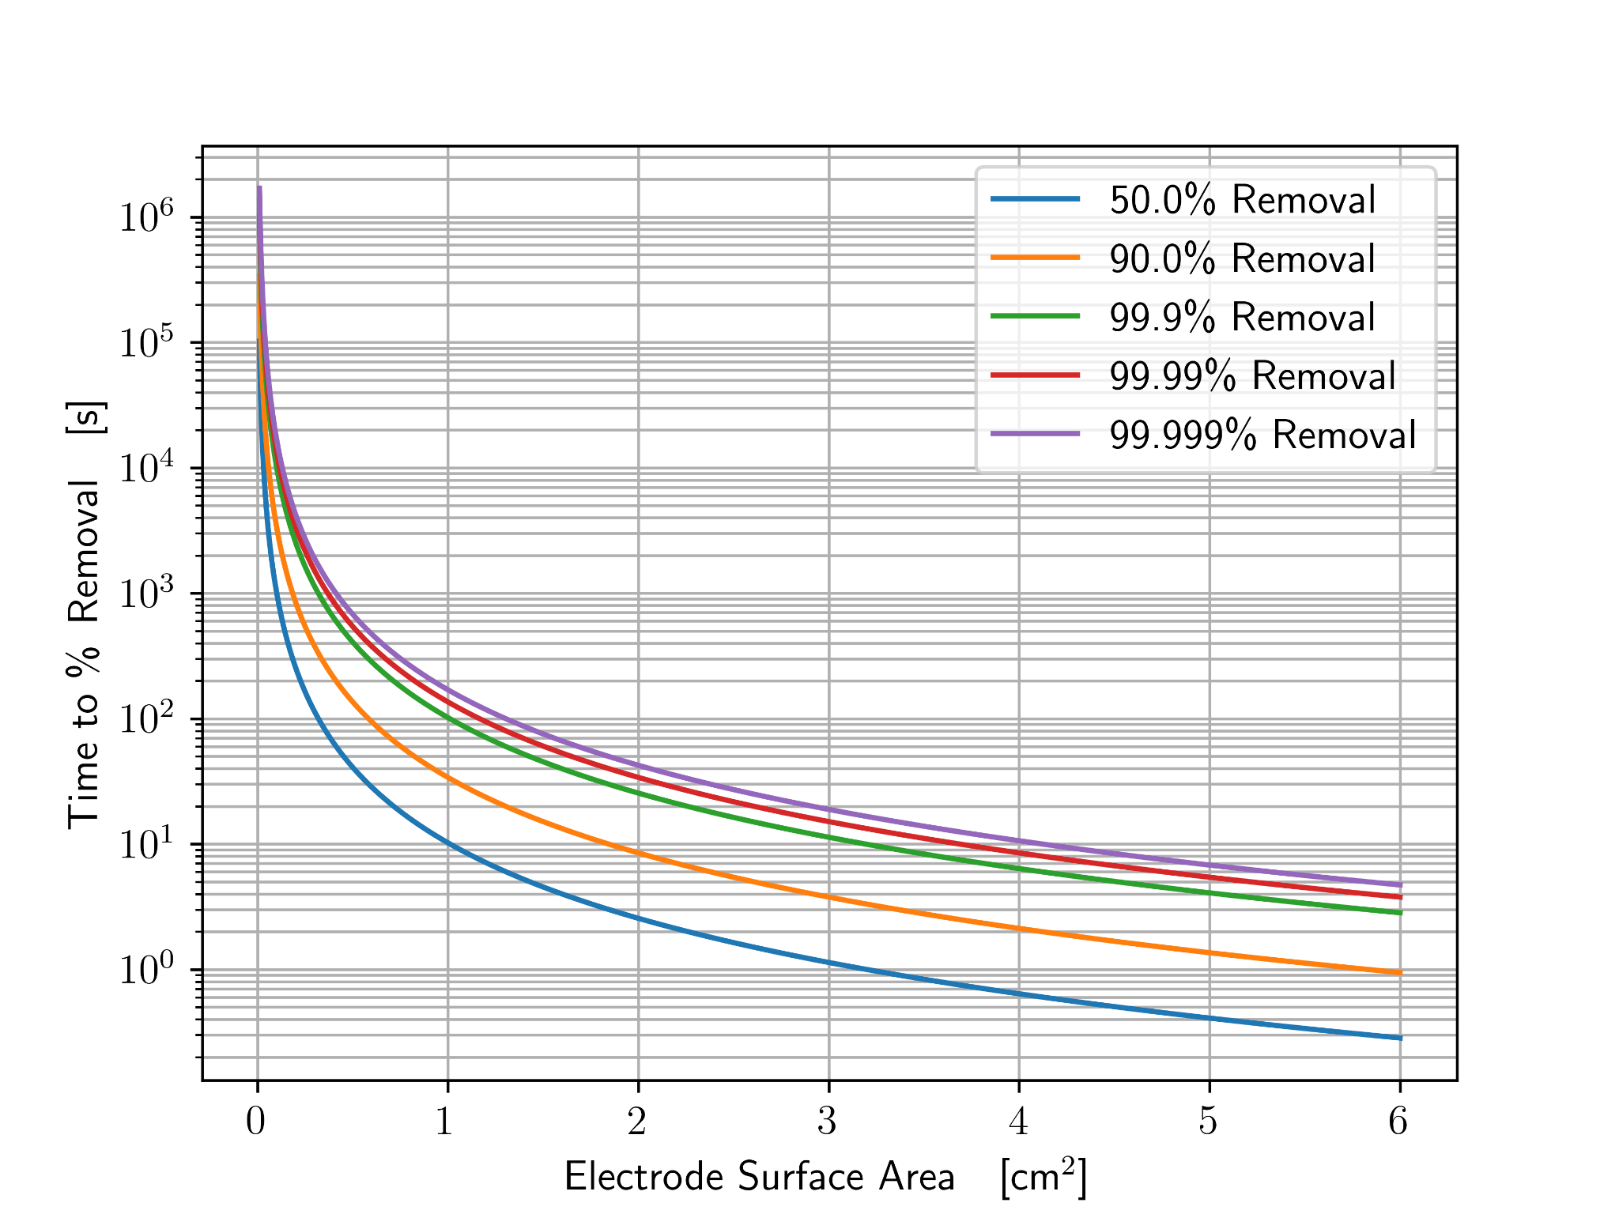

Electrochemical Module with FLiBe
Tungsten electrodes
Remove U without BeF dissolution
Higher efficiency than FSV (99%>95%)
1.88m, .375cm
Assuming diffusion driven mixing, Sand’s law for time to efficiency
42.67708325s
VERY conservative assumption
Pipe flow speed of 7.8 m/s yields length of 330m
Not feasible to fit into containment, need to slow down
Diverge flow to decrease linear velocity
Notes:
https://www.elmettechnologies.com/product/125-x-72-tungsten-rod-ground/?gQT=1

Slide 22
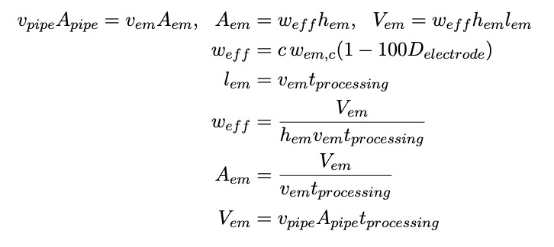
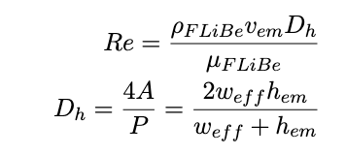
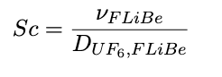
Volume of electrochemical module (em) is known
43.1 m3 fuel-salt
117.4 m3 combined total channel volume
Minimizing the module length and width yields:
channel flow width of 0.65 m
channel length of 8.86 m
channel velocity of .2 m/s
Reynolds number of 7182 -> turbulent flow so mixing is advection driven
779680 electrodes ($118M)
Schmidt number for relation of advective to diffusive mass transport -> 204513.92
Electrochemical Module with FLiBe
Notes:
chose 5 channels to maximize fuel salt height in channel while also minimizing number of channels

Slide 23
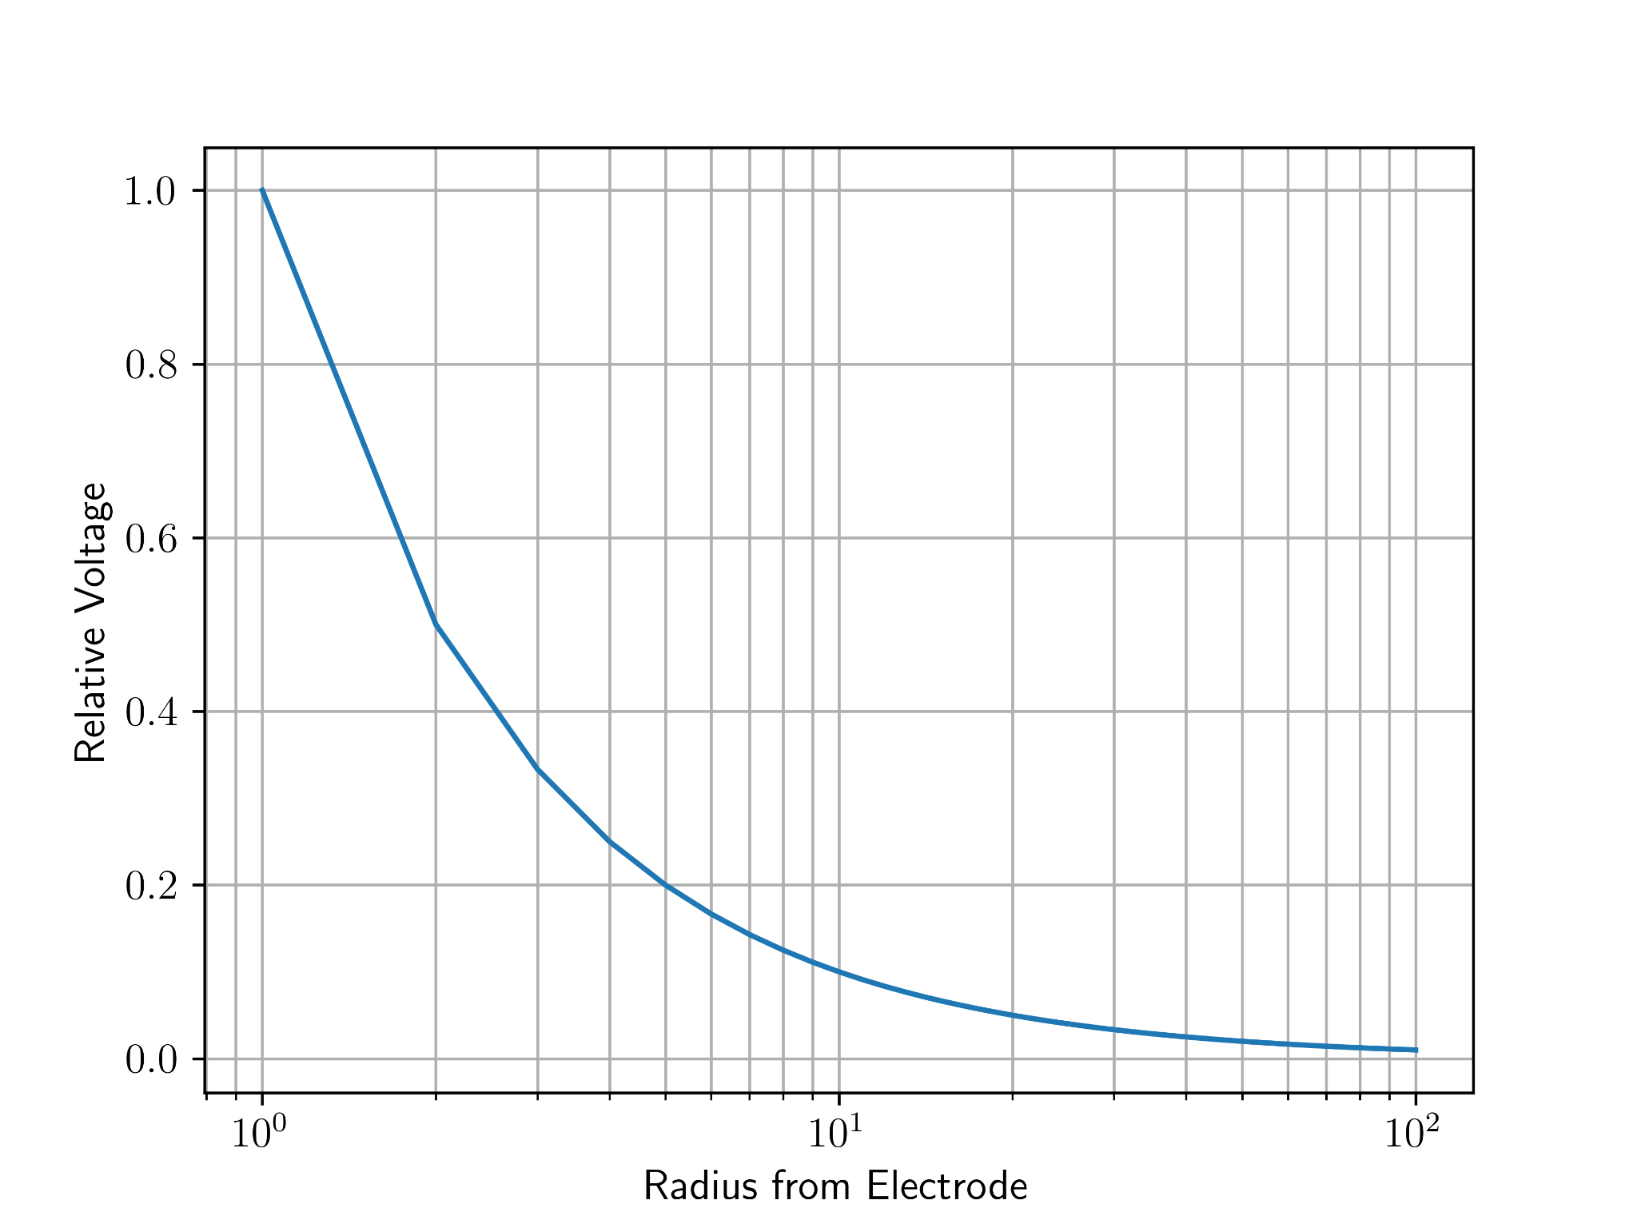
Electrochemical Module with FLiBe
Number of electrodes per meter
Was based on diffusion, now electrical resistivity of FLiBe (20% -> 10 /m)
Redid calculations changing 100 to 10, keeping channel flow width and length
3.43 m combined total channel width
45.6 m3 combined total channel volume
2640 electrodes ($0.401M)
Reynolds number did not change
Notes:
chose 5 channels to maximize fuel salt height in channel while also minimizing number of channels

Slide 24
Additional Components

Slide 25
Thermal Cycle
Convert from Rankine to sCO₂ Brayton cycle
Better fit for MSBR temperature range
Lower pressure and higher thermal efficiency
Fluid | Cycle | η | Pressure [atm] | Temp Range [°C]
Water | Rankine | 43.4%* | 250 | <550
sCO2 | Brayton | >50% | 200 | 550-850
He | Brayton | 54% | 80 | >850

Slide 26
Heat Exchanger
40% of the noble metals were estimated to plate out within the MSBR’s metallic heat exchanger
Problematic in sLOFA, kW of decay heat being produced
Change the heat exchanger material from metallic to graphite
Decreases noble metal plate out
Use SiC buffers to decrease tritium release to secondary loop

Slide 27
Cost Analysis

Slide 28
Cost Increases vs. MSBR
Primary heat exchangers
Swapping for graphite
Smaller but harder to manufacture
Secondary side: swapping for SCO₂ Brayton system
Better thermal utilization
More effective at temperature
Fuel-salt inventory
Increased
Electricity used in electrodes
Notes:
David

Slide 29
Cost reductions
feedwater heating system
MSBR used a water cooling system to remove heat so a rankine cycle could be used
With a Brayton cycle supercritical CO2 is used
Selling Tritium
$30000 per gram or $7444.14 per day
Extended reactor online time
no need to shut down to remove fission product build up
Notes:
David

Slide 30
Remaining Work

Slide 31
Thickness of channel walls
Total electrical demand of all electrodes
Total cost of each electrochemical module
compared to FSV
Cost of large hot cell for each electrochemical module
automatic removal of electrodes, INL has a facility doing this
Cost of Graphite HX
Cost of sCO₂ cycle compared to Rankine
Cost of added fuel-salt
Cost of tritium and other waste products
Notes:
David

Slide 32
References
[1] U. S. D. of Energy. Pathways to Commercial Liftoff: Advanced Nuclear. Tech. rep. Department
of Energy, 2024.
[2] A. P. P. Association. “America’s Electricity Generating Capacity”. In: (2024).
[3] W. N. Association. “Nuclear Power Reactors”. In: (2025).
[4] GIF R&D OUTLOOK FOR GENERATION IV NUCLEAR ENERGY SYSTEMS. Tech. rep.
Generation IV International Forum, 2018. url: https : / / www . gen - 4 . org / resources /
reports/gif- research- and- development- outlook- generation- iv- nuclear- energy-
systems-2018.
[5] H. Li et al. “Study on tritium transport characteristics in fluoride-salt-cooled high-temperature
advanced reactor”. In: International Journal of Hydrogen Energy 56 (2024), pp. 1101–1110.
issn: 0360-3199. doi: https://doi.org/10.1016/j.ijhydene.2023.12.199. url: https:
//www.sciencedirect.com/science/article/pii/S0360319923064996.
[6] P. N. Haubenreich and J. R. Engel. “Experience with the Molten-Salt Reactor Experiment”.
In: Nuclear Applications and Technology 8.2 (1970), pp. 118–136. doi: 10.13182/NT8-2-118.
eprint: https://doi.org/10.13182/NT8-2-118. url: https://doi.org/10.13182/NT8-2-
118.
[7] R. C. Robertson. CONCEPTUAL DESIGN STUDY OF A SINGLE-FLUID MOLTEN-SALT
BREEDER REACTOR. Tech. rep. comp.; Oak Ridge National Lab. (ORNL), Oak Ridge, TN
(United States), Jan. 1971. doi: 10.2172/4030941. url: https://www.osti.gov/biblio/
4030941.
18
[8] Molten Salt Reactors and Thorium Energy. en. Elsevier, 2024. isbn: 9780323993555. doi:
10.1016/C2021- 0- 01689- 8. url: https://linkinghub.elsevier.com/retrieve/pii/
C20210016898 (visited on 03/22/2025).
[9] Advanced Nuclear. en-US. url: https : / / liftoff . energy . gov / advanced - nuclear - 2/
(visited on 03/22/2025).
[10] U. A. E. C. D. of Reactor Development and Technology. AN EVALUATION OF THE MOLTEN
SALT BREEDER REACTOR. Tech. rep. US ATOMIC ENERGY COMISSION, 1972.
[11] V. Dostál. “A supercritical carbon dioxide cycle for next generation nuclear reactors /”. In:
154 (June 2005).
[12] C. W. Forsberg et al. “Tritium Control and Capture in Salt-Cooled Fission and Fusion
Reactors: Status, Challenges, and Path Forward”. In: Nuclear Technology 197.2 (2017), pp. 119–139.
doi: 10.13182/NT16-101. url: https://doi.org/10.13182/NT16-101.
[13] M. C. Cannon et al. “Adsorption of Xenon and Argon on Graphite”. In: Nuclear Science and
Engineering 12.1 (1962), pp. 4–9. doi: 10.13182/NSE62-A25362.
[14] V. Ignatiev et al. “Intergranular tellurium cracking of nickel-based alloys in molten Li, Be,
Th, U/F salt mixture”. In: Journal of Nuclear Materials 440.1 (2013), pp. 243–249. issn:
0022-3115. doi: https : / / doi . org / 10 . 1016 / j . jnucmat . 2013 . 05 . 001. url: https :
//www.sciencedirect.com/science/article/pii/S0022311513007071.
[15] B. Gurovich et al. “Fractographic studies and tensile strength of MPG-6 graphite based on
uncalcined coke, neutron-irradiated at a high temperature”. In: Nuclear Materials and Energy
35 (2023), p. 101453. issn: 2352-1791. doi: https://doi.org/10.1016/j.nme.2023.101453.
url: https://www.sciencedirect.com/science/article/pii/S2352179123000923.
[16] B. J. Riley et al. “Molten salt reactor waste and effluent management strategies: A review”.
In: Nuclear Engineering and Design 345 (2019), pp. 94–109. issn: 0029-5493. doi: https:
//doi.org/10.1016/j.nucengdes.2019.02.002. url: https://www.sciencedirect.com/
science/article/pii/S002954931930024X.
[17] IAEA. Non-baseload Operation in Nuclear Power Plants: Load Following and Frequency Control
Modes of Flexible Operation. Tech. rep. IAEA, 2018.
Notes:
David
infinite batch burnup 412 equations

Slide 33
Questions?

Slide 34
Template

Slide 35
TITLE

Slide 36
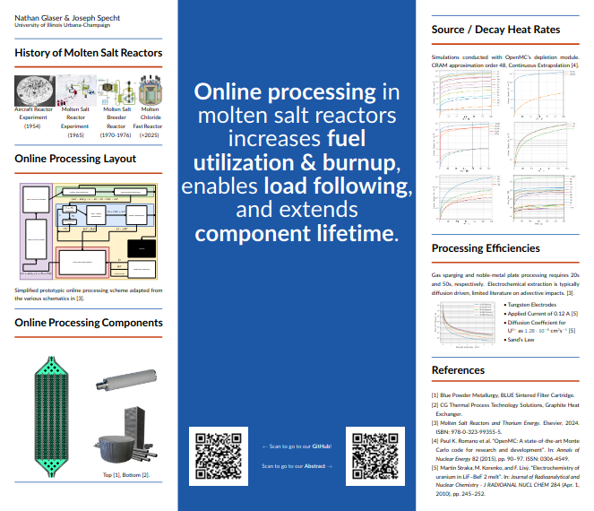

Student Conference

